Slide 1

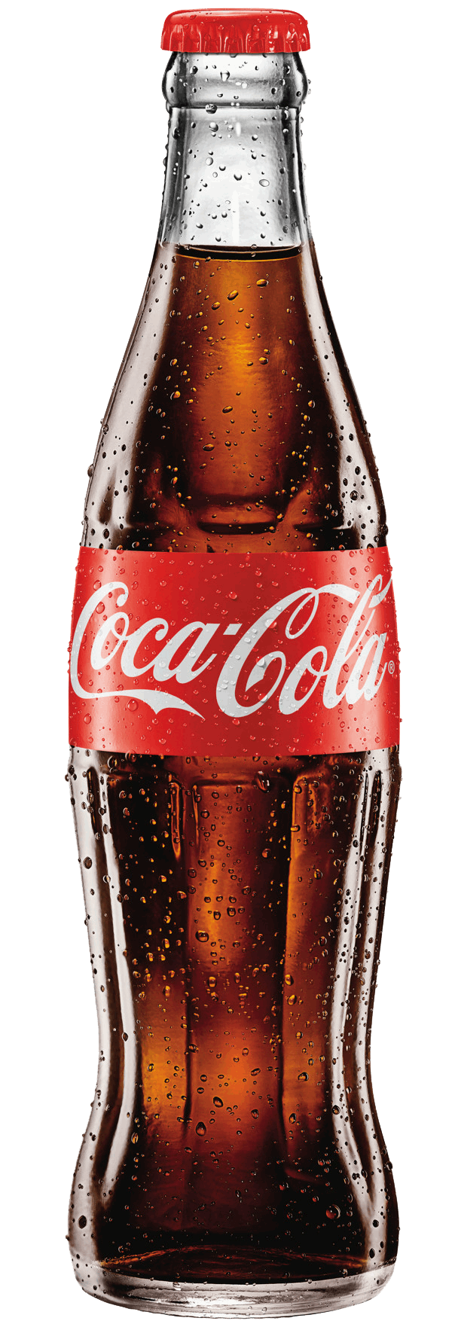
COCA COLA
COCA COLA
The Coca-Cola Company
COCA COLA
Group 3
Shuhan Chen, Eujin Kang, Jose Medrano, Yoojin Hong, Patrick Green
COCA COLA

Slide 2
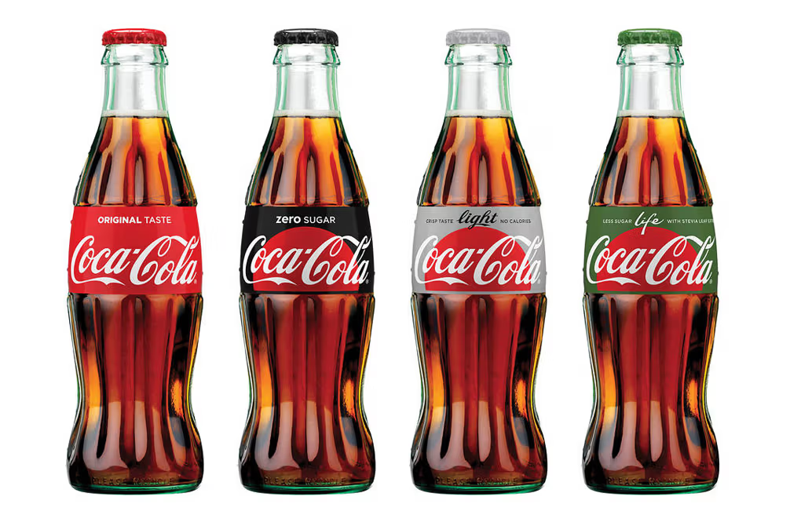
Table of Contents
p. 3 Executive Summary
p. 6 Recommendation 1
p. 8 Recommendation 2
p. 10 Recommendation 3
p. 12 Summary

Slide 3
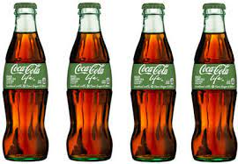
Executive Summary
Expanding Healthy Products and Tap Into New Markets
text
Act 1
Coca-Cola has built its sugary product reputation through beverages known for their high sugar content and satisfying taste.
Act 2
The Health Drinks Market size is expected to grow from USD 344.36 billion in 2023 to USD 408.80 billion by 2028, at a CAGR of 3.49% during the forecast period (2023-2028)
Act 3
Expanding its healthy drink offerings allows Coca-Cola to tap into the health-conscious consumer market

Slide 4

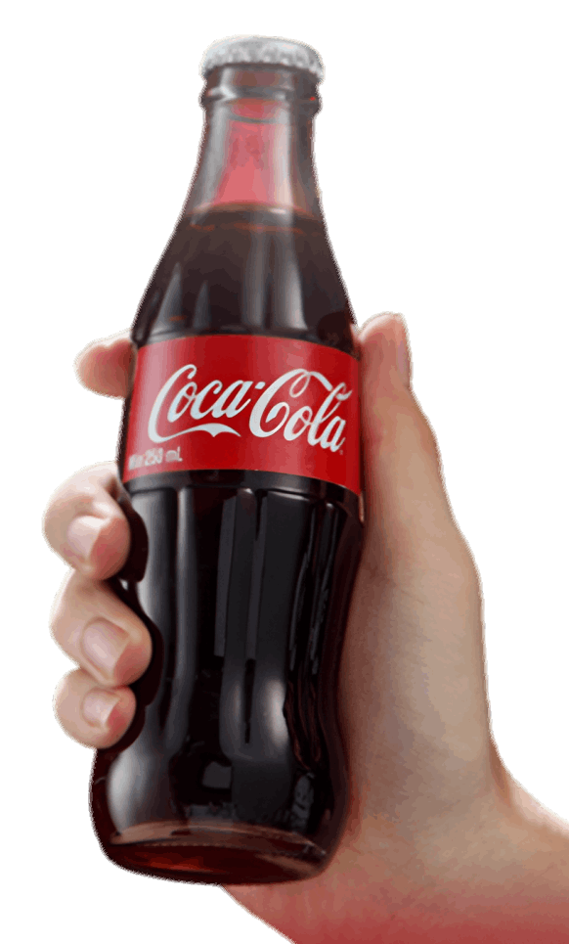
The market size for healthy drinks is expected to grow
18.6% increase from 2023 to 2028

Slide 5
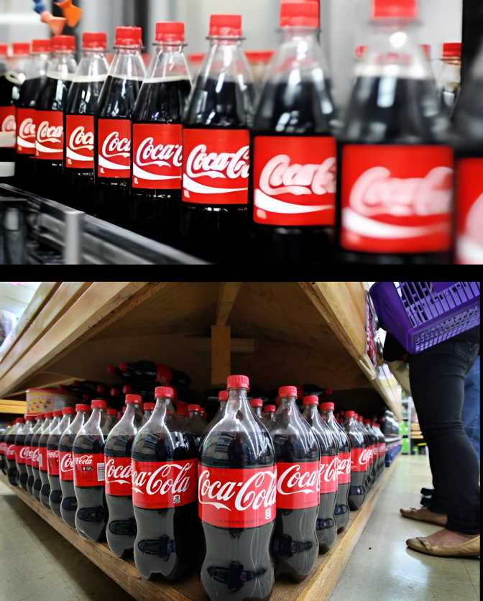
Recommendations
Expand the Menu of Different Healthy Products to Reach New Customers
Partner with Leading Health Organizations
Acquire Athletes and Sports Teams to Sponsor Healthy Products

Slide 6
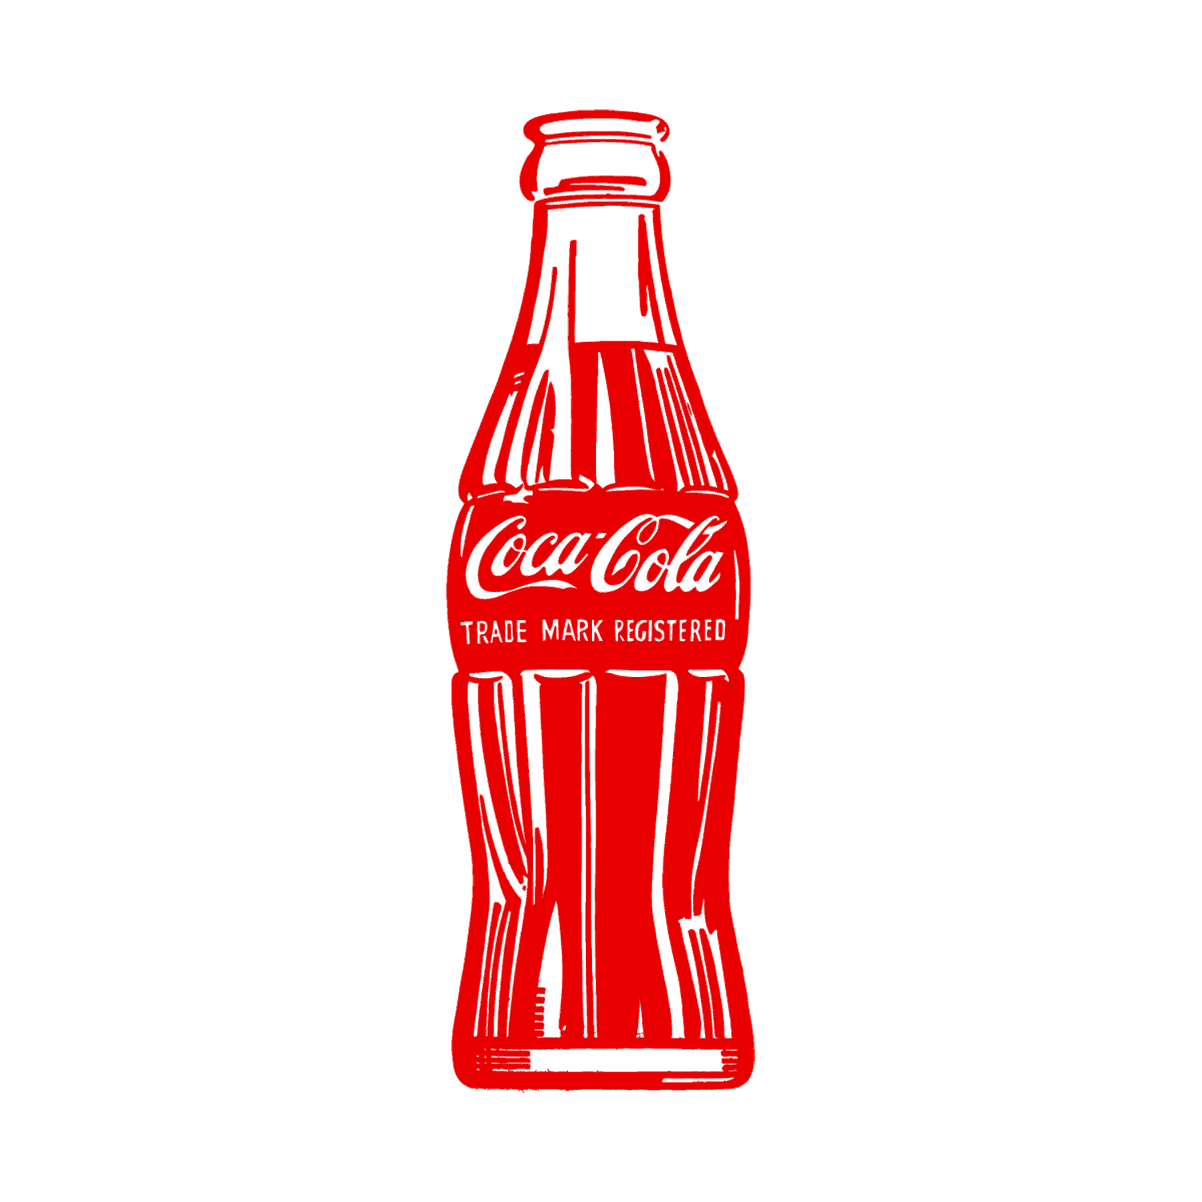
Expand the Menu of Different Healthy Products to Reach New Customers

Slide 7
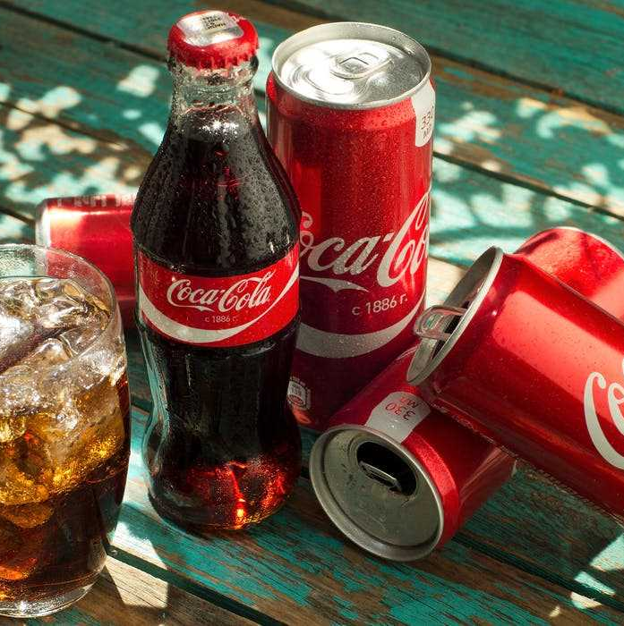
Full Year 2020 Results
Net revenues declined 5%: $8.6 billion
zero-sugar line of Coca-Cola sales growth: 3%

Slide 8
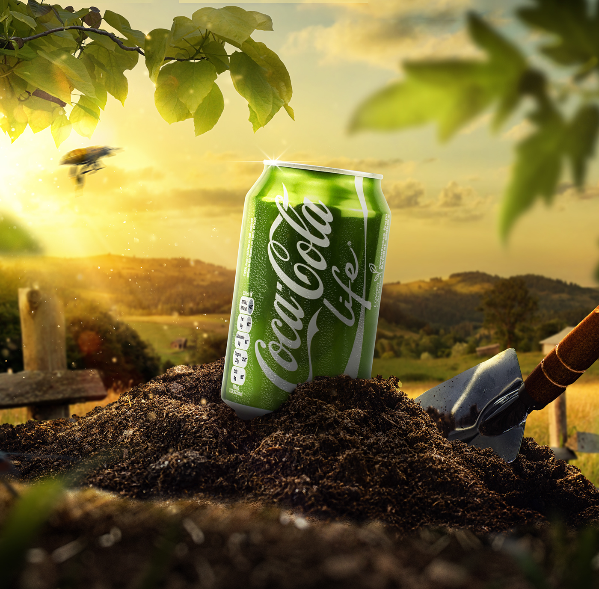
How Will We Expand Options?
Encourage consumer feedback and incorporate feedback into product refinement and marketing strategies
Shift the main focus of drinks to low calorie and healthy products
Notes:
implement this strategy. target marketing
strategy to make this a successful transition. original

Slide 9

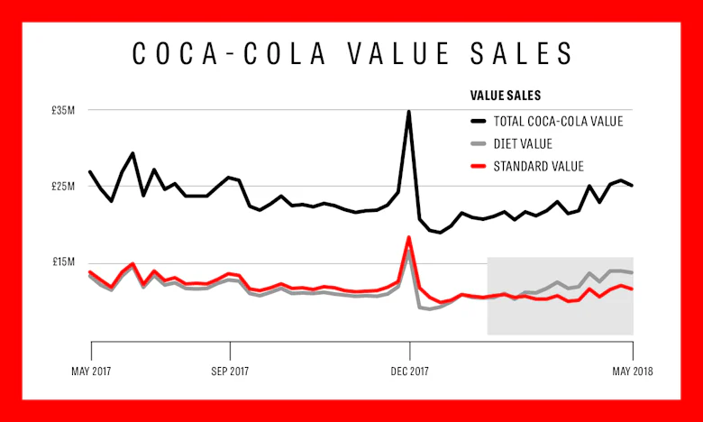
02. Partner with Leading Health Organizations
Coca-Cola has sponsored American Heart Association events, such as heart walks and educational campaigns, which aim to promote physical activity and heart health awareness among the public.

Slide 10

Before and After Partnerships
BEFORE
Marketing Focus: Originally, Coca-Cola focused on marketing sugary drinks without addressing health concerns.
Rising Awareness and Criticism: As awareness of the health risks associated with sugary drinks increased, Coca-Cola faced criticism for contributing to obesity, diabetes, and heart disease.
AFTER
Brand Image Enhancement: Partnering with the American Heart Association helps improve Coca-Cola's image.
Countering Negativity: This collaboration counters negative perceptions about the health impacts of sugary drinks.
Consumer Trust: Increase of trust and loyalty, especially among health-conscious market segments
Notes:
Before partnering with health organizations like the American Heart Association (AHA), Coca-Cola’s public perception and business strategy were primarily focused on marketing its traditional lineup of sugary drinks, without significant emphasis on health or wellness concerns.As public awareness about the health risks associated with sugary drinks grew, Coca-Cola began to face more criticism. Health advocates and medical professionals were increasingly vocal about the links between sugar consumption and health issues such as obesity, type 2 diabetes, and cardiovascular diseases.
By associating with a respected health organization like the AHA, Coca-Cola benefits from an enhanced brand image. This can be particularly valuable in mitigating the negative perceptions related to the health effects of its traditional sugary beverages. Consumers may perceive Coca-Cola's products as more health-conscious due to the association with the AHA, potentially leading to increased trust and customer loyalty among health-aware segments of the market.
Strategic Partnerships: In response, Coca-Cola began partnering with health organizations like the American Heart Association

Slide 11
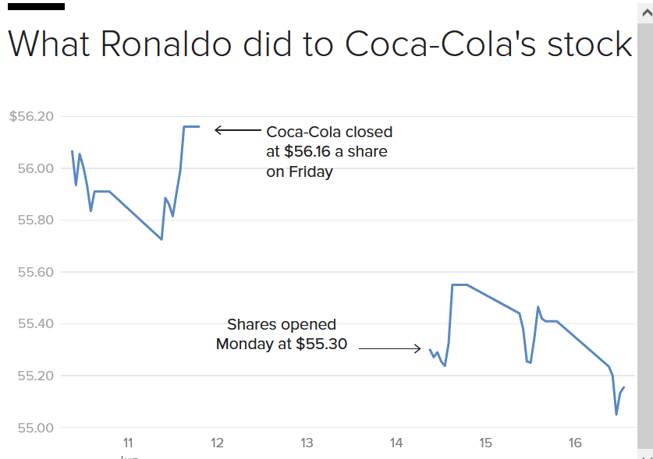

03. Acquire Athletes and Sports Teams to Sponsor Healthy Products
Coke’s share price fell from $56.10 to $55.22 "almost immediately" after Ronaldo's press conference
The market value of Coca-Cola dropped by $4 billion, from $242 billion to $238 billion.
Depicts Athletes Influence on Consumers and Products
Notes:
Athletes and sports teams engage with a vast audience and market, igniting inspiration among fans to purchase and experience the products

Slide 12

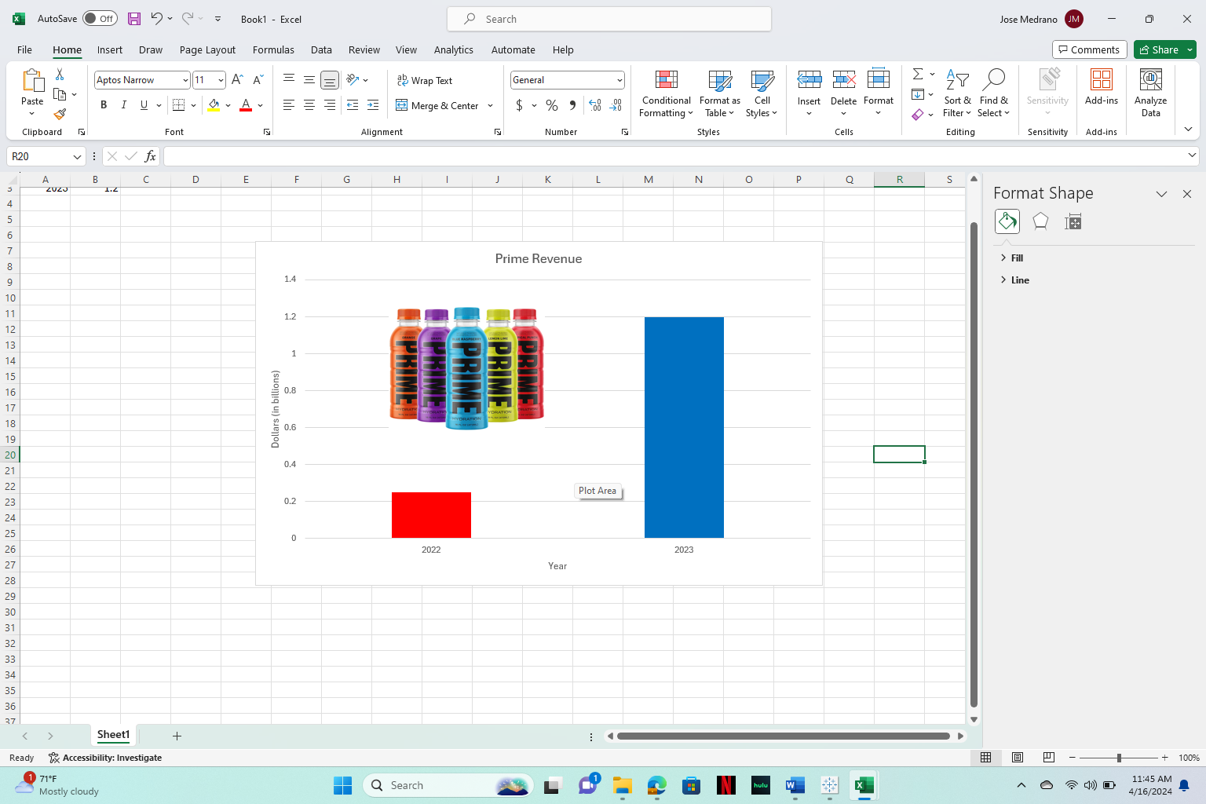
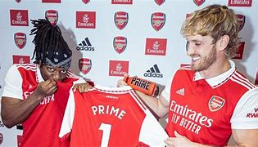


Sponsorship with Athletes and Sport Teams Drives Up Revenue
Prime’s strategic sponsorships with teams and athletes have contributed to their growth
Demonstrating this, Prime’s revenue increased from $200 million in 2022 to $1.2 billion in 2023

Slide 13
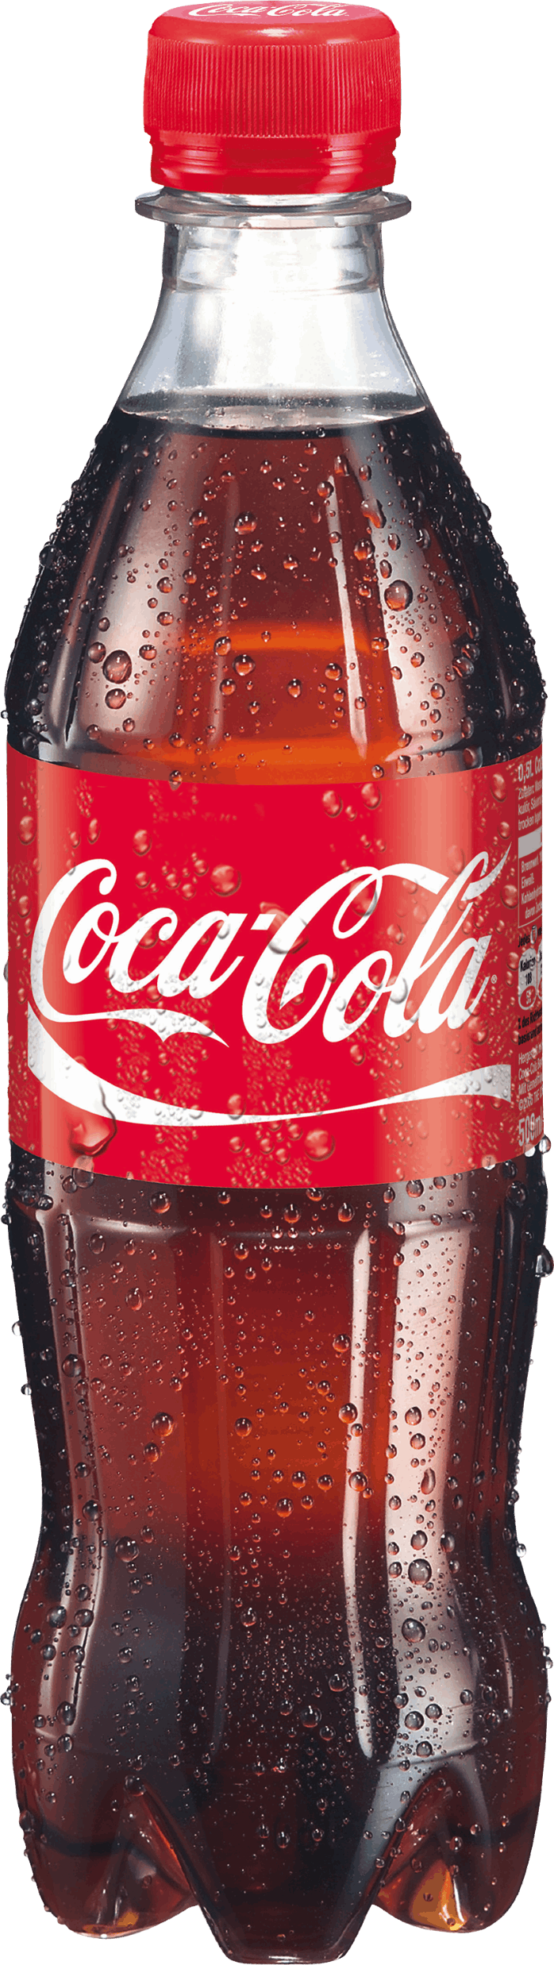
Summary
It is essential for Coke to keep up with new market trends regarding healthy products.
Expanding the range of healthy products, partnering with health organizations, and sponsoring athletes to endorse healthy options taps into new markets, creating new revenue streams and generating additional wealth.

Slide 14
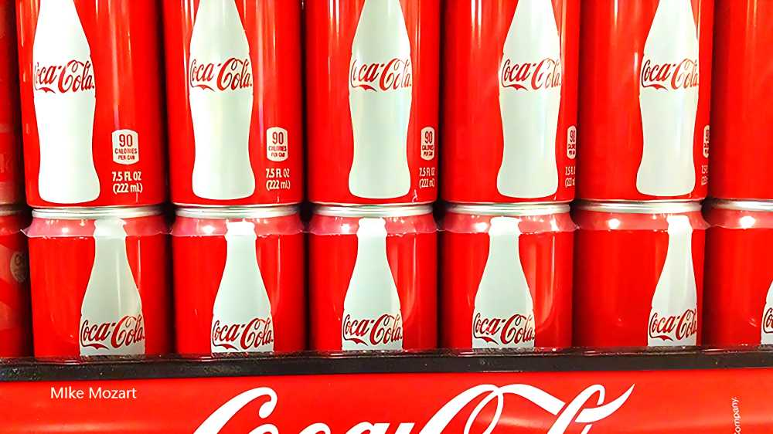
Appendix
Coca-Cola Reports Fourth Quarter and Full Year 2020 Results :: The Coca-Cola Company (KO)
Ronaldo’s Coca Cola gesture followed by $4bn drop in company’s market value - The Athletic
Energy Drink Company Prime, Co-Founded By KSI, On Track To Hit Over $1.2B In Annual Sales In 2023 (yahoo.com)
Health Drinks Market - Size, Share & Industry Trends (mordorintelligence.com)
Is Coca-Cola Bad for You? 6 Side Effects of Drinking It (eatthis.com)
Health Drink Market-Global Size, Share & Industry Trends | IMR (introspectivemarketresearch.com)

